Slide 1



Batch Normalization Embeddings for Deep Domain Generalization
Segu, Mattia, Alessio Tonioni, and Federico Tombari. "Batch normalization embeddings for deep domain generalization." Pattern Recognition 135 (2023): 109115.
Alireza Mazochi

Slide 2
Overview
Introduction
Method
Results
Conclusions

Slide 3
Introduction

Slide 4
Title of the Article
“Batch Normalization
Embeddings
for Deep
Domain Generalization”

Slide 5
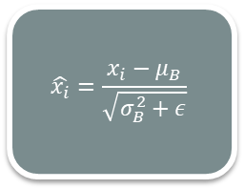
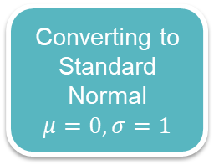
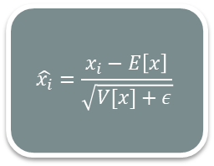
Batch Normalization
Training Phase
$$\hat{x_{i}}=\frac{x_{i}−μ_{B}}{\sqrt{σ_{B}^{2}+ε}}$$
Internal Covariate Shift
Converting to Standard Normal
$$μ=0, σ=1$$
Testing
Phase
$$\hat{x_{i}}=\frac{x_{i}−E\left[x\right]}{\sqrt{V[x]+ε}}$$

Slide 6
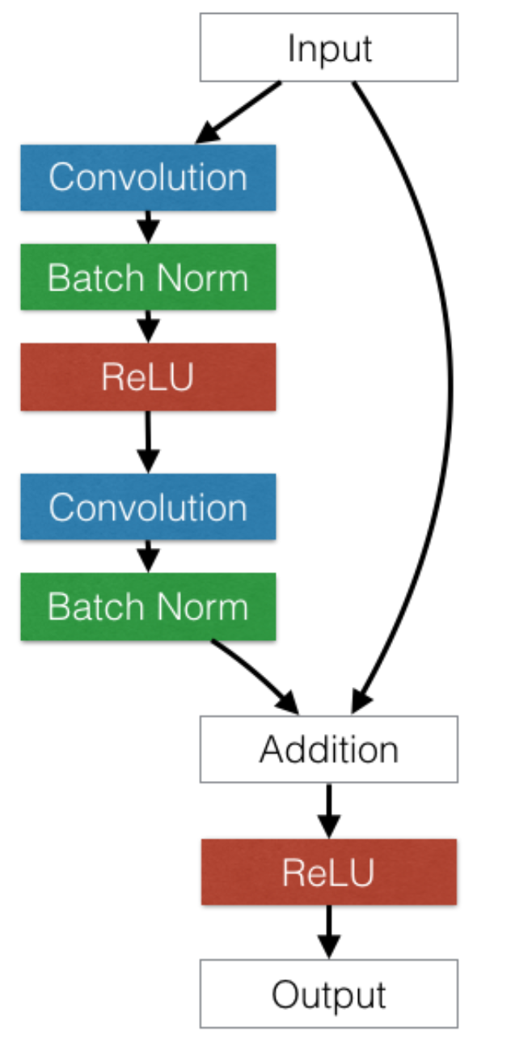
Batch Normalization on ResNet

Slide 7
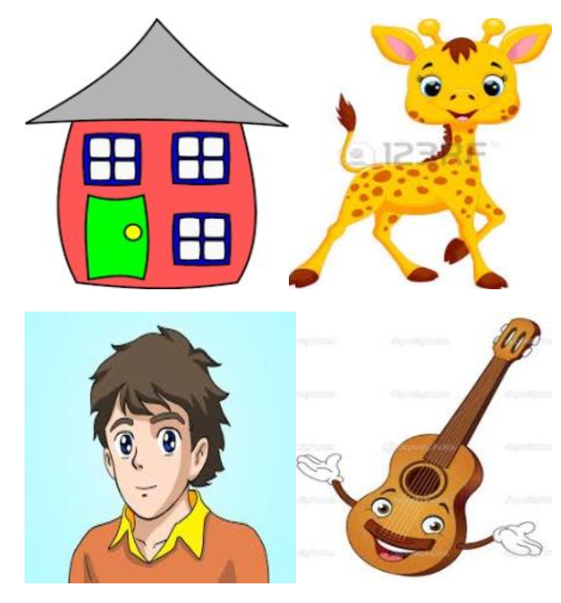
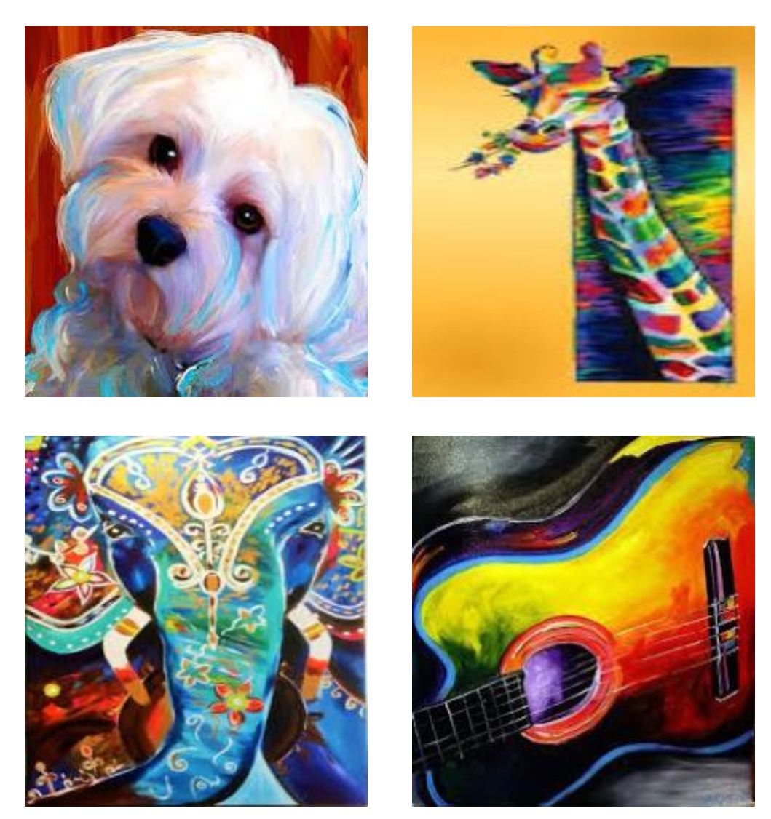
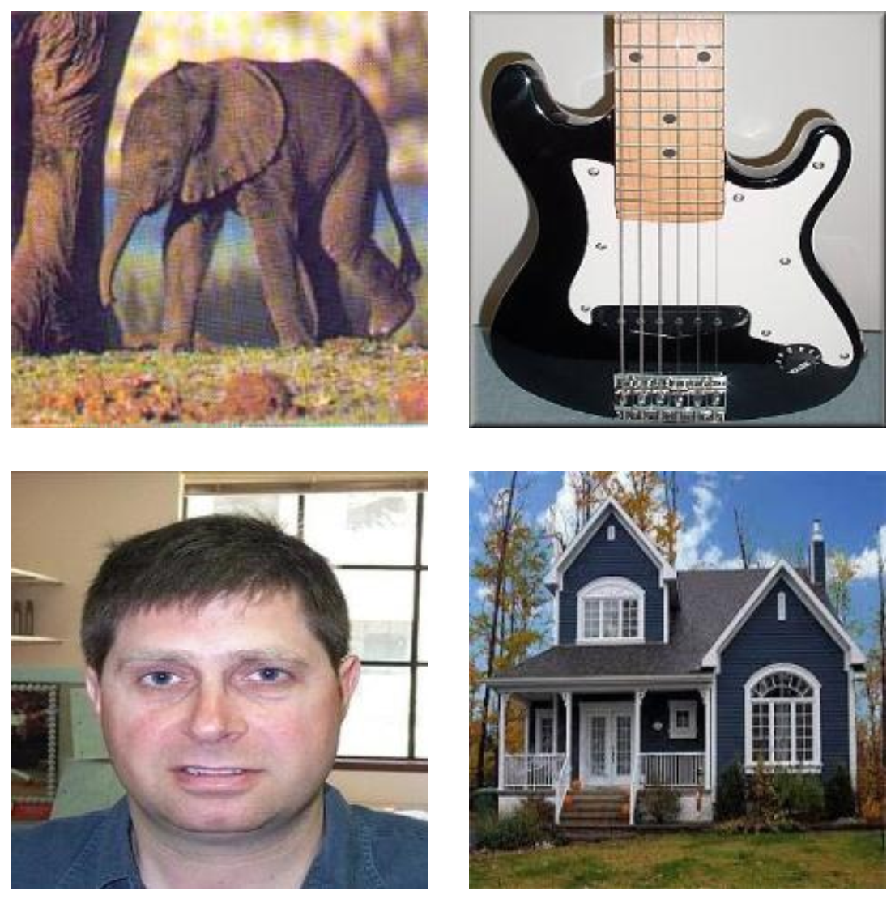
Domain Generalization
Cartoon
Art Paining
Photo
Domain Shift
Domain vs Class

Slide 8
Related Works
Domain Adaptation
Supervised Data on Unseen Domain
Robust
to Unseen Domain
Domain Generalization
Fine Tuning

Slide 9
Related Works
Feature Level
Data Level
Domain Invariant Features
Model Based
Meta Learning
Domain Generalization
Domain Specific Representation
Bach Normalization Embedding

Slide 10
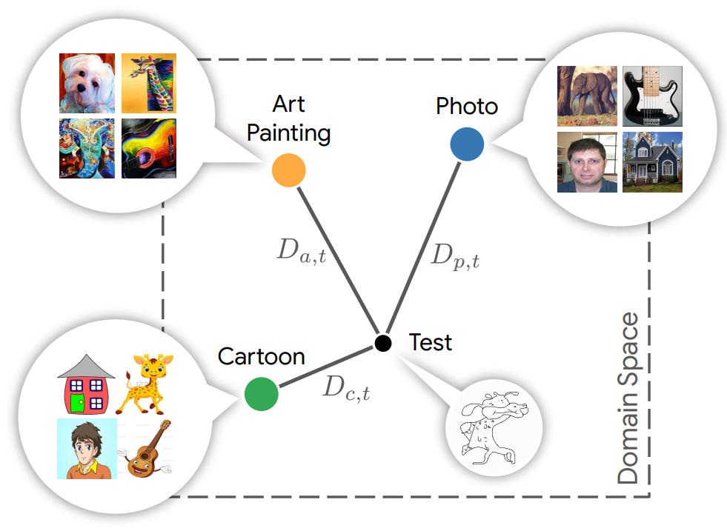
Method Overview
Train Domain Dependent Representation
Collect Domain Statistics
Distance Function for Domain Membership
Using Bach Normalization for Each Domain

Slide 11
Method

Slide 12
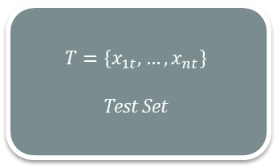
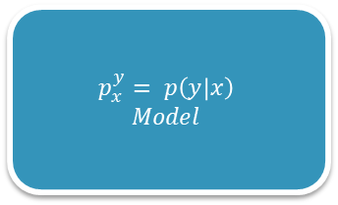
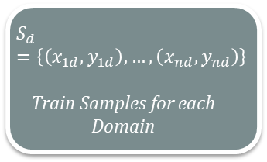
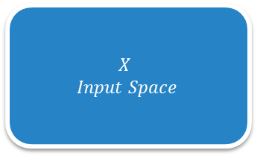
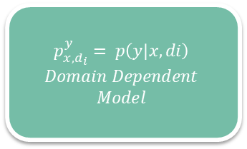
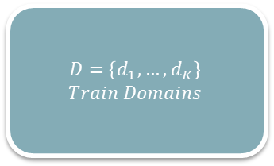
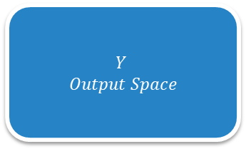
Problem Formulation
$$X$$
$$Input Space$$
$$S_{d}=\left\{\left(x_{1d},y_{1d}\right),…, \left(x_{nd},y_{nd}\right)\right\}$$
Train Samples for each Domain
$$p_{x}^{y}= p\left(y | x\right)$$
$$Model$$
$$D=\left\{d_{1}, …, d_{K}\right\}$$
$$Train Domains$$
$$Y$$
$$Output Space$$
$$T=\left\{x_{1t}, …, x_{nt}\right\}$$
Test Set
$$p_{x, d_{i}}^{y}= p\left(y | x,di\right)$$
$$Domain Dependent$$
$$Model$$

Slide 13
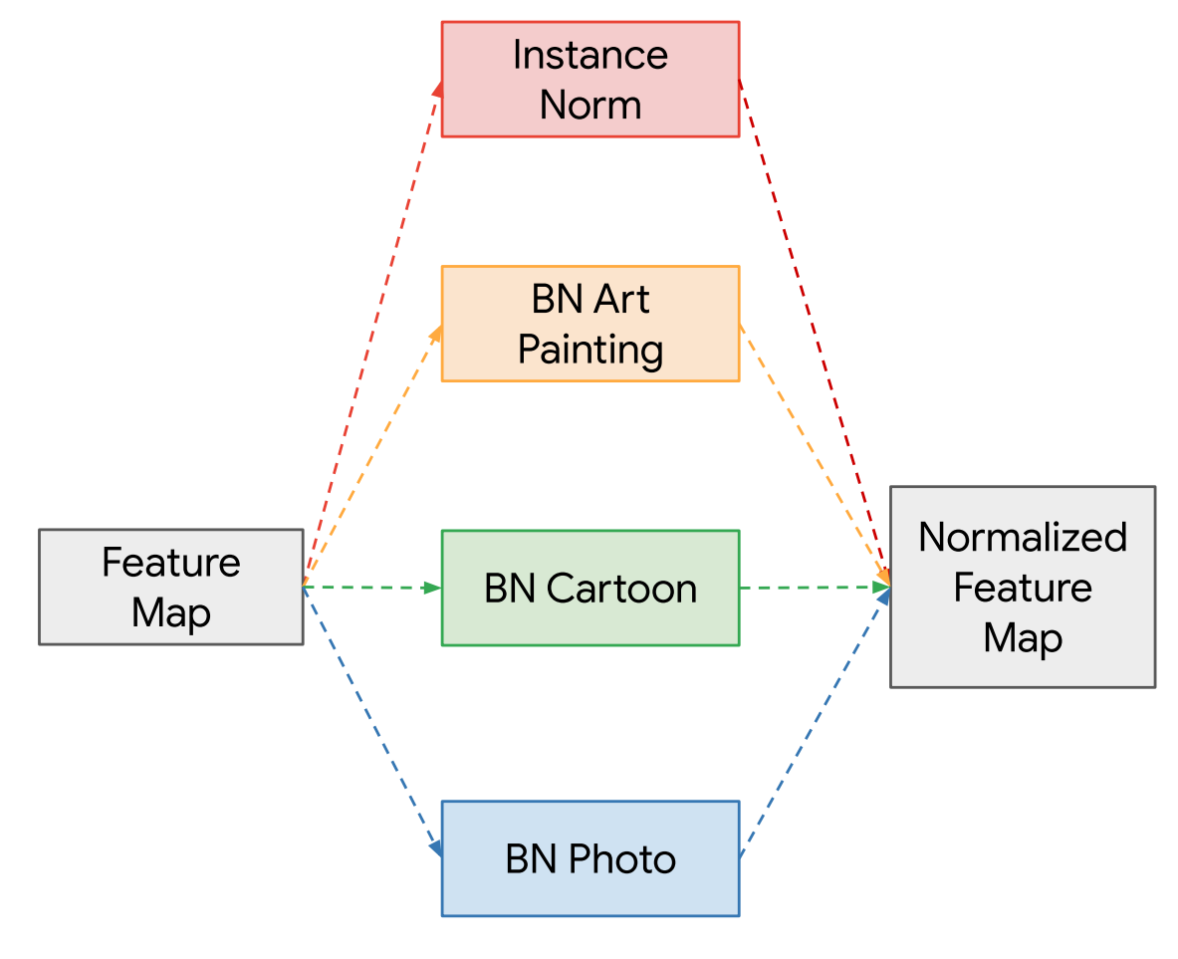
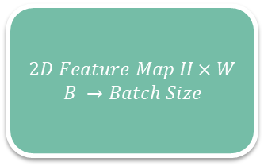
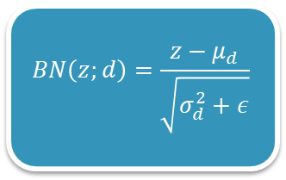
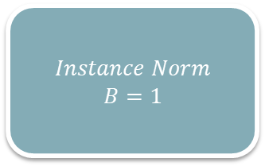
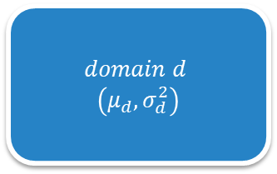
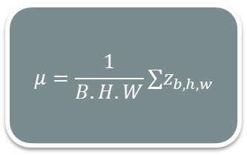
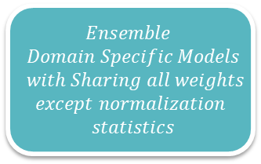
Multi-Source Domain Alignment Layer
$$domain d$$
$$\left(μ_{d}, σ_{d}^{2}\right)$$
$$2D Feature Map H×W$$
$$B →Batch Size$$
$$BN\left(z;d\right)=\frac{z−μ_{d}}{\sqrt{σ_{d}^{2}+ε}}$$
$$μ=\frac{1}{B.H.W}∑z_{b,h,w}$$
$$Ensemble$$
$$Domain Specific Models$$
$$with Sharing all weights$$
$$except normalization$$
$$statistics$$
$$Instance Norm$$
$$B=1$$

Slide 14
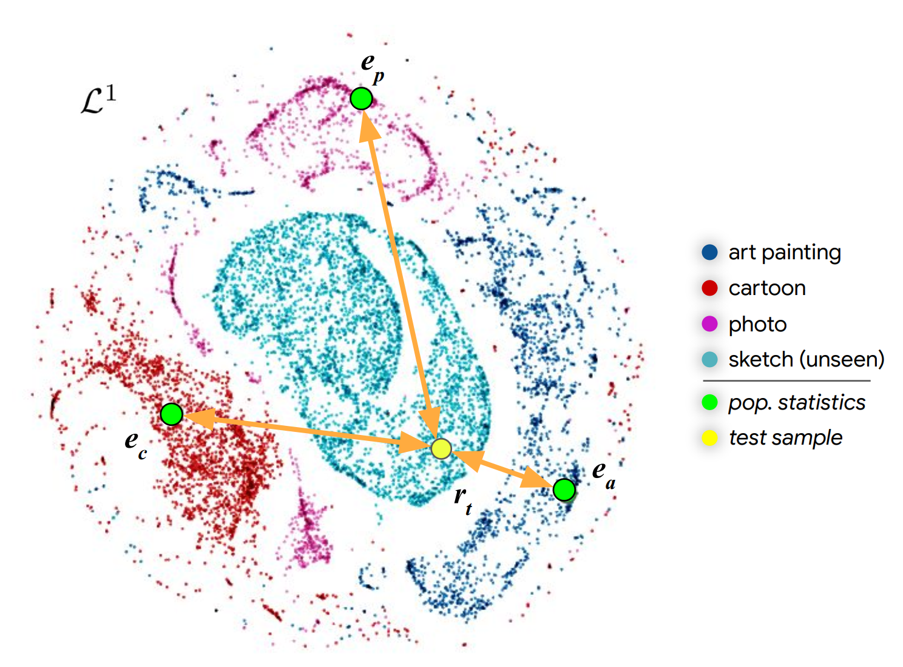
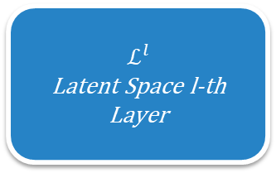
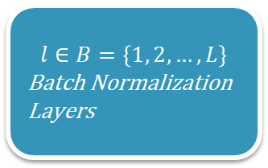
Domain Localization
$$l∈B=\left\{1, 2,…, L\right\}$$
Batch Normalization Layers
$$ℒ^{l}$$
Latent Space l-th Layer

Slide 15
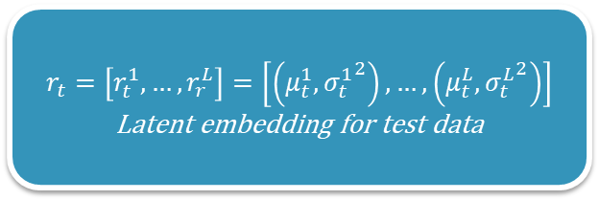
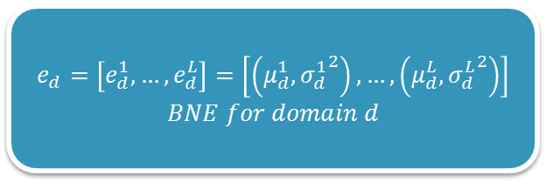
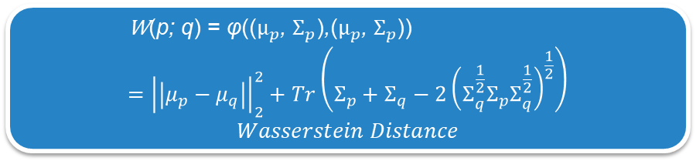
Domain Localization
$$e_{d}=\left[e_{d}^{1},…, e_{d}^{L}\right]=\left[\left(μ_{d}^{1},{σ_{d}^{1}}^{2}\right),…,\left(μ_{d}^{L},{σ_{d}^{L}}^{2}\right)\right]$$
$$BNE for domain d$$
$$r_{t}=\left[r_{t}^{1},…, r_{r}^{L}\right]=\left[\left(μ_{t}^{1},{σ_{t}^{1}}^{2}\right),…,\left(μ_{t}^{L},{σ_{t}^{L}}^{2}\right)\right]$$
Latent embedding for test data
$$\text{W}\text{(}\text{p}\text{; }\text{q}\text{) = }\text{φ}\text{(}\text{(}μ_{p}\text{,} Σ_{p}\text{)}\text{,}\text{(}μ_{p}\text{,} Σ_{p}\text{)}\text{)} \\ ={\left|\left|μ_{p}−μ_{q}\right|\right|}_{2}^{2}+Tr\left(Σ_{p}+Σ_{q}−2{\left(Σ_{q}^{\frac{1}{2}}Σ_{p}Σ_{q}^{\frac{1}{2}}\right)}^{\frac{1}{2}}\right)$$
$$Wasserstein Distance$$

Slide 16
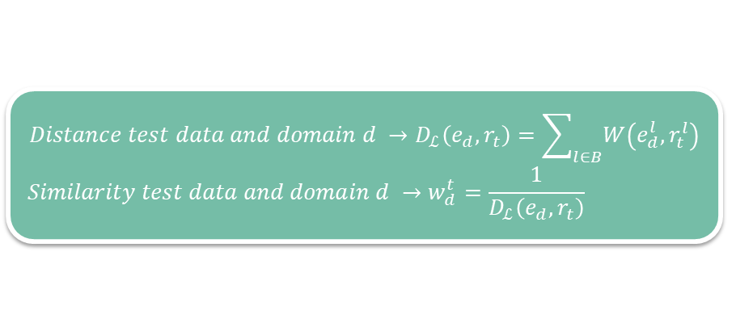

Domain Localization
$${Distance test data and domain d →D}_{ℒ}\left(e_{d}, r_{t}\right)=\sum_{l∈B}{W\left(e_{d}^{l}, r_{t}^{l}\right)}$$
$$Similarity test data and domain d →w_{d}^{t}=\frac{1}{D_{ℒ}\left(e_{d}, r_{t}\right)}$$
$$f\left(x_{t}\right)=\frac{\sum_{d∈D}{w_{d}^{t} ∗f\left(x_{t}|d\right)}}{\sum_{d∈D}{w_{d}^{t}}}$$

Slide 17
Evaluation

Slide 18
Dataset
Name | #Domain | #Category
PACS | 4 (Art Painting, Cartoon, Photo, Sketch) | 7
Office-31 | 3 | 31
Office-Caltech | 4 (Office-31 + Caltech-256) | 10

Slide 19
Evaluation Protocol
Name | Evaluation Procedure
PACS | Leave-one-domain-out
Office-31 | Leave-one-domain-out
Office-Caltech | Leave-one-domain-out Leave-two-domain-out

Slide 20
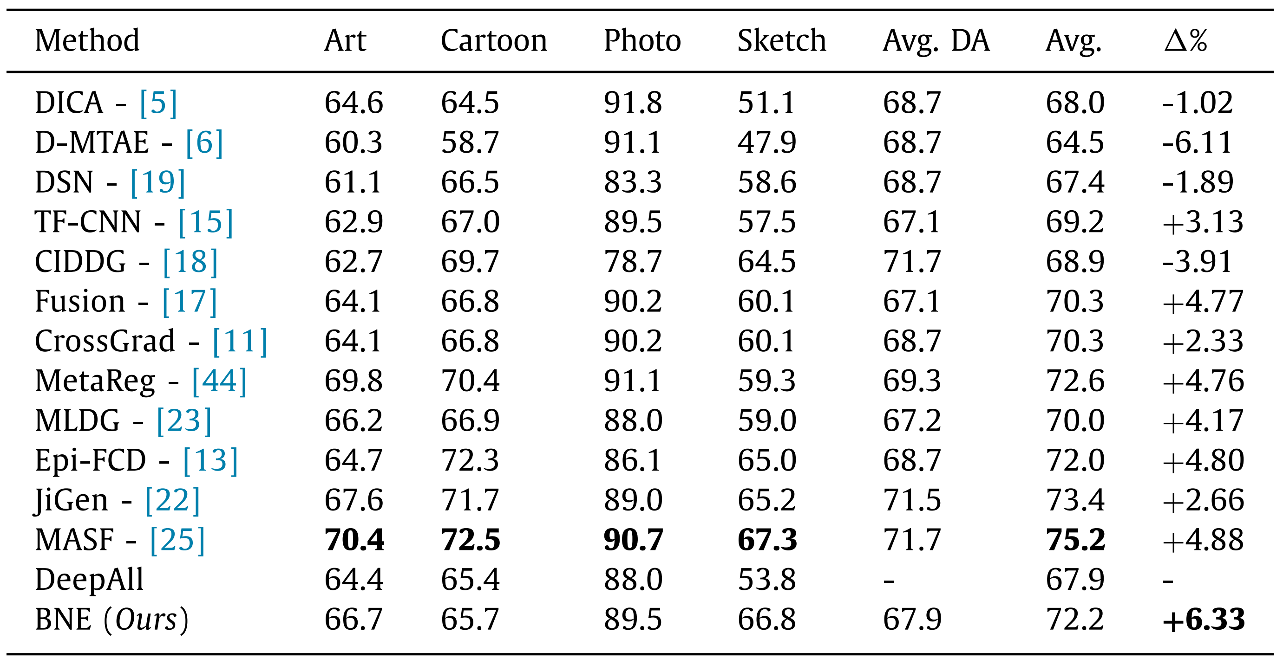
Comparison on PACS with AlexNet

Slide 21
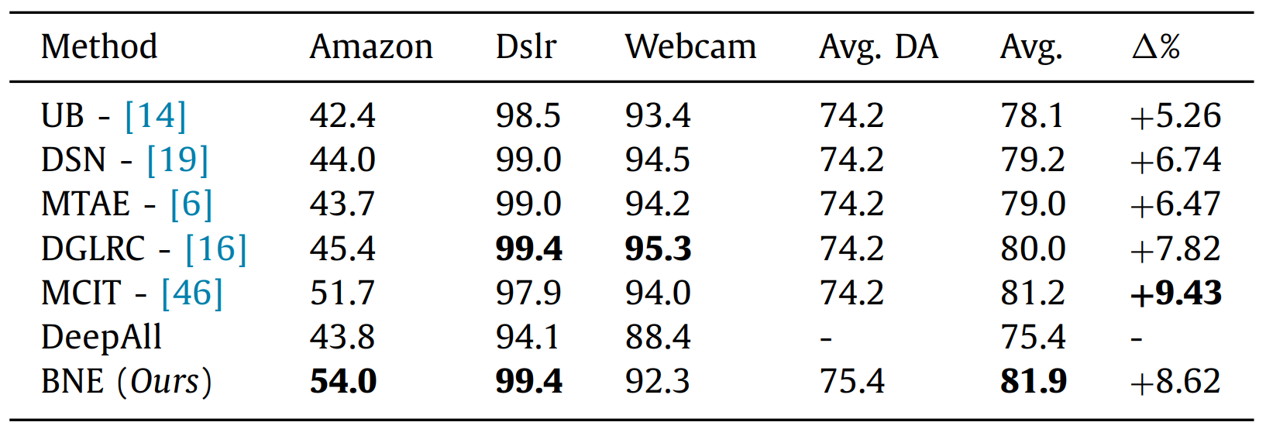
Comparison on Office-31 with AlexNet

Slide 22
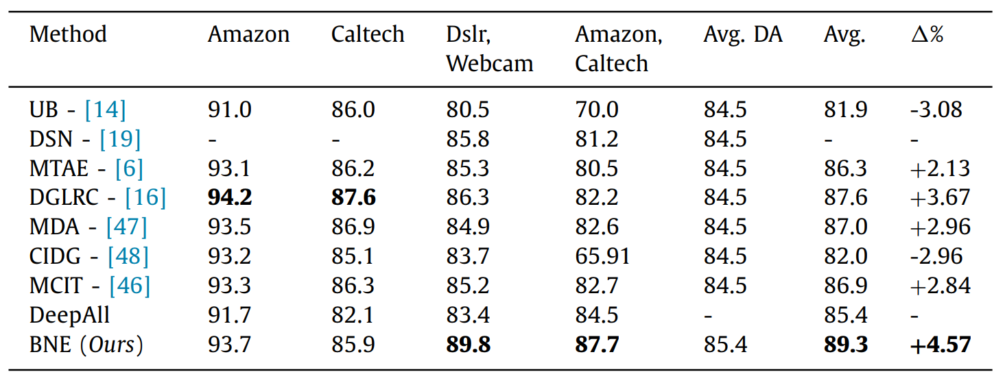
Comparison on Office-Caltech

Slide 23
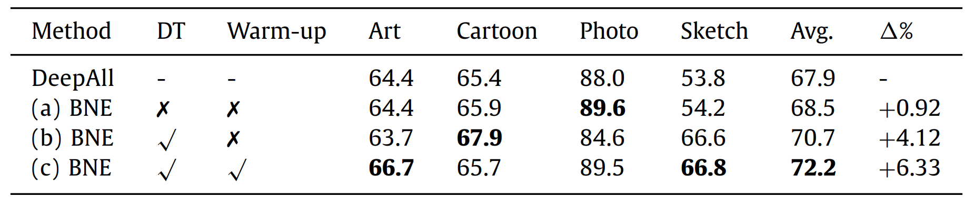
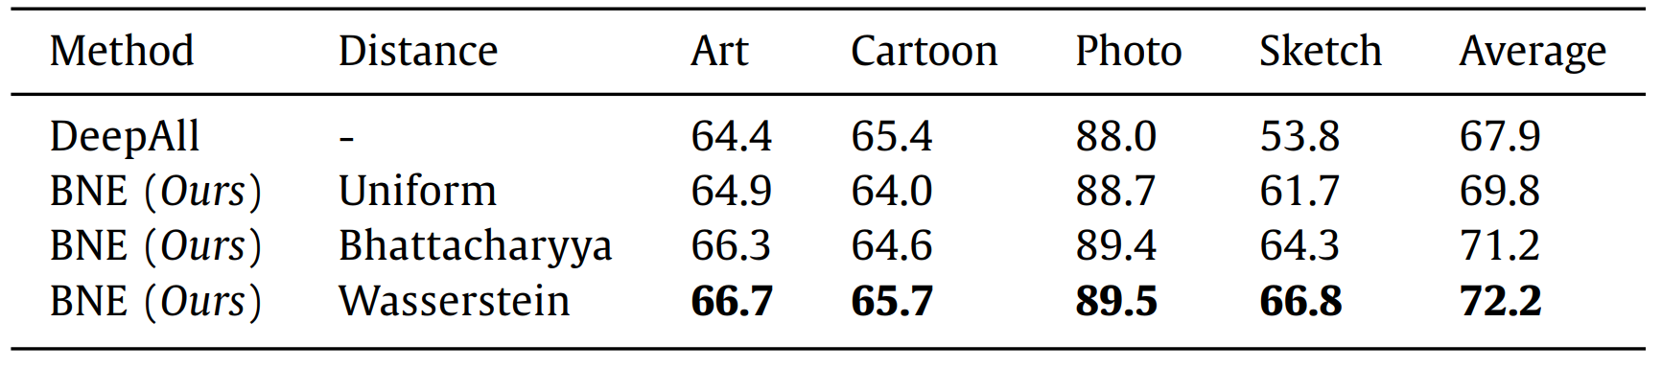
Ablation Study PACS with AlexNet

Slide 24
Conclusions

Slide 25
Pros and Cons
Pros
Light and easy to apply
Cons
No code available
No need to huge amount of data
Simple assumption
Increasing runtime
Focus only on image data
Understandable
Comprehensive results

Slide 26
Future works
Changing Formula
Use few target samples
Test other data domains (for example text)

Slide 27
References
[1] Segu, Mattia, Alessio Tonioni, and Federico Tombari. "Batch normalization embeddings for deep domain generalization." Pattern Recognition 135 (2023): 109115.

Slide 28
Thanks For Attention!

